Slide 1
Data Analytics
Mr. Shrikrishna Anand Narvekar
Assitant Professor
Computer Engineering department
Agnel Institute of Technology and Design

Slide 2
About the course
Will involve some math & programming but certainly no derivations!
Heavily conceptual.
What's & Whys of data analytics.
  Statistics to Machine Learning
  Techniques & tools you will apply
  Where & why some methods work some does not
  Background logic
  Lots of application!

Slide 3
Format of the course
Focus on a single topic per session
Begin with general introduction to the topic
Related concepts explained
Sample problems and solutions, algorithms, methods
Implement solutions using tools (R Tool)
Don’t hesitate to provide feedback, ask questions
We will learn how to apply statistics/machine learning and use them for data analytics!

Slide 4
Course Overview
Unit 1
Introduction to data analytics and data-Preprocessing
Concept of supervised and unsupervised learning
Sampling methods and resampling
Descriptive statistics
Linear regression and multiple regression

Slide 5
Course Overview
Unit 2
Inferential statistics
Classification
Ensemble methods
Clustering
Association rules

Slide 6
Course Overview
Unit 3
DBMS, NoSQl database, Basic Data Analytics Lifecycle
Unit 4
Data Analytics using R-Theory, Methods and case studies

Slide 7
Books and Readings
“Data Science & Big Data Analytics”, David Dietrich, Barry Hiller, EMC education services, Wiley publications, 2012
"The Elements of Statistical Learning", Trevor Hastie, Robert Tibshirani, Jerome Friedman, Second Edition, 2011, Springer
"Database System Concepts", Silberschatz A., Korth H., Sudarshan S., 6th edition, McGraw Hill Publishers.
“Beginning R: The Statistical Programming Language”, Mark Gardner, Wrox Press (WILEY), 2012
“NoSQL For Dummies”, Adam Fowler, John Wiley & Sons, 2015
“Applied statistics and probability for engineers”. Montgomery, Douglas C., and George C. Runger. John Wiley & Sons, 2010

Slide 8
Objectives
Understand foundations of data analytics so that you can interpret and communicate results and make informed decisions
Study and learn to apply common statistical methods and machine learning algorithms to solve business problems
Learn to work with popular tools to analyze and visualize data; more importantly encourage consistency across departments on analytics/tools used
Working with data storage and for deployment of applications
Learn methods for mastering and applying emerging concepts and technologies for continuous data-driven improvements to your business processes
Transform complex analytics into routine processes
Notes:
Understand foundations of data analytics so that you can interpret and communicate results and make informed decisions
Learn the basics of data analytics, which will help you understand the results you get from data analysis. This understanding will enable you to explain these results clearly to others and make better decisions based on data.
Study and learn to apply common statistical methods and machine learning algorithms to solve business problems
Learn about statistical methods and machine learning techniques. These are tools that help you analyze data and find patterns or predictions, which can be used to solve real-world business challenges.
Learn to work with popular tools to analyze and visualize data; more importantly encourage consistency across departments on analytics/tools used
Get familiar with popular software and tools that are used to analyze and create visual representations of data. It’s important to ensure that everyone in your organization uses the same tools and methods to maintain consistency in data analysis.
Working with data storage and for deployment of applications
Understand how to store data securely and effectively. Also, learn how to deploy (launch) data-driven applications that can be used by others in your business.
Learn methods for mastering and applying emerging concepts and technologies for continuous data-driven improvements to your business processes
Stay updated with the latest trends and technologies in data analytics. By applying these new concepts, you can continuously improve your business processes based on data-driven insights.
Transform complex analytics into routine processes
Take complicated data analyses and turn them into regular, automated processes. This means making data analysis a normal part of how your business operates, so that it’s easier and faster to make decisions based on data.

Slide 9
The world of data
Large data source available!
Need to make value out of data!
Personalized content! – YouTube, Instagram, Facebook, Google
Making performance decisions on all sectors
  Business, medicine, social networks, bioinformation's, sports, media , politics, environment etc
Notes:
Large Data Sources Available
In today’s digital world, an enormous amount of data is generated every second. This comes from social media posts, online shopping, banking transactions, mobile apps, GPS sensors, and even smart devices like fitness bands.
👉 Example: Every time you swipe your card at a shop, post a selfie on Instagram, or watch a video on YouTube, data is being generated and stored.
Need to Make Value out of Data
Having a lot of data is not useful unless we process it to extract meaningful insights. Data analytics helps us understand hidden patterns, trends, and relationships within the data.
👉 Example: Online stores like Amazon don’t just collect your purchase history; they analyze it to recommend products you are most likely to buy, thereby increasing sales.
Personalized Content (YouTube, Instagram, Facebook, Google)
Companies use data analytics to personalize user experiences by showing tailored content, ads, or suggestions. This makes the platforms engaging and relevant for each individual.
👉 Example: If you watch cooking videos on YouTube, the platform will suggest more recipe videos. Similarly, if you search for “running shoes” on Google, you may start seeing ads for sports shoes on Instagram or Facebook.
Making Performance Decisions Across All Sectors
Data analytics supports decision-making in almost every field—business, healthcare, sports, media, politics, environment, and more. It helps improve efficiency, reduce risks, and enhance performance.
👉 Examples:
In healthcare, doctors use patient data and AI tools to detect diseases early.
In sports, coaches analyze player statistics to design winning strategies.
In business, companies analyze customer data to design better marketing campaigns.
In environment, data from sensors helps monitor air quality and predict natural disasters.

Slide 10
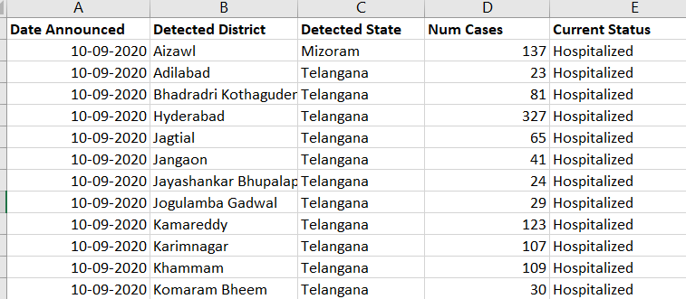
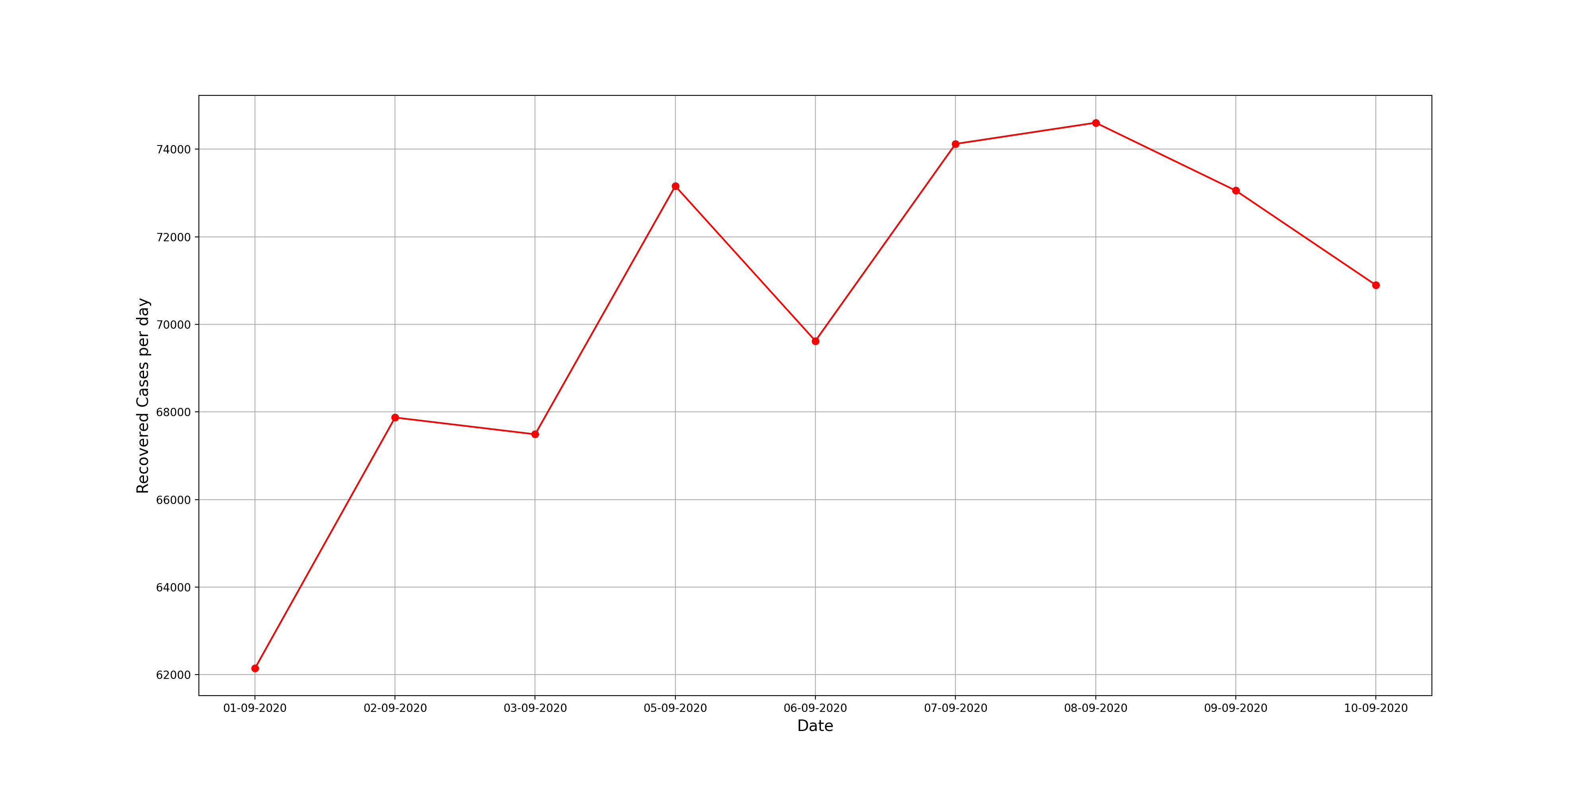
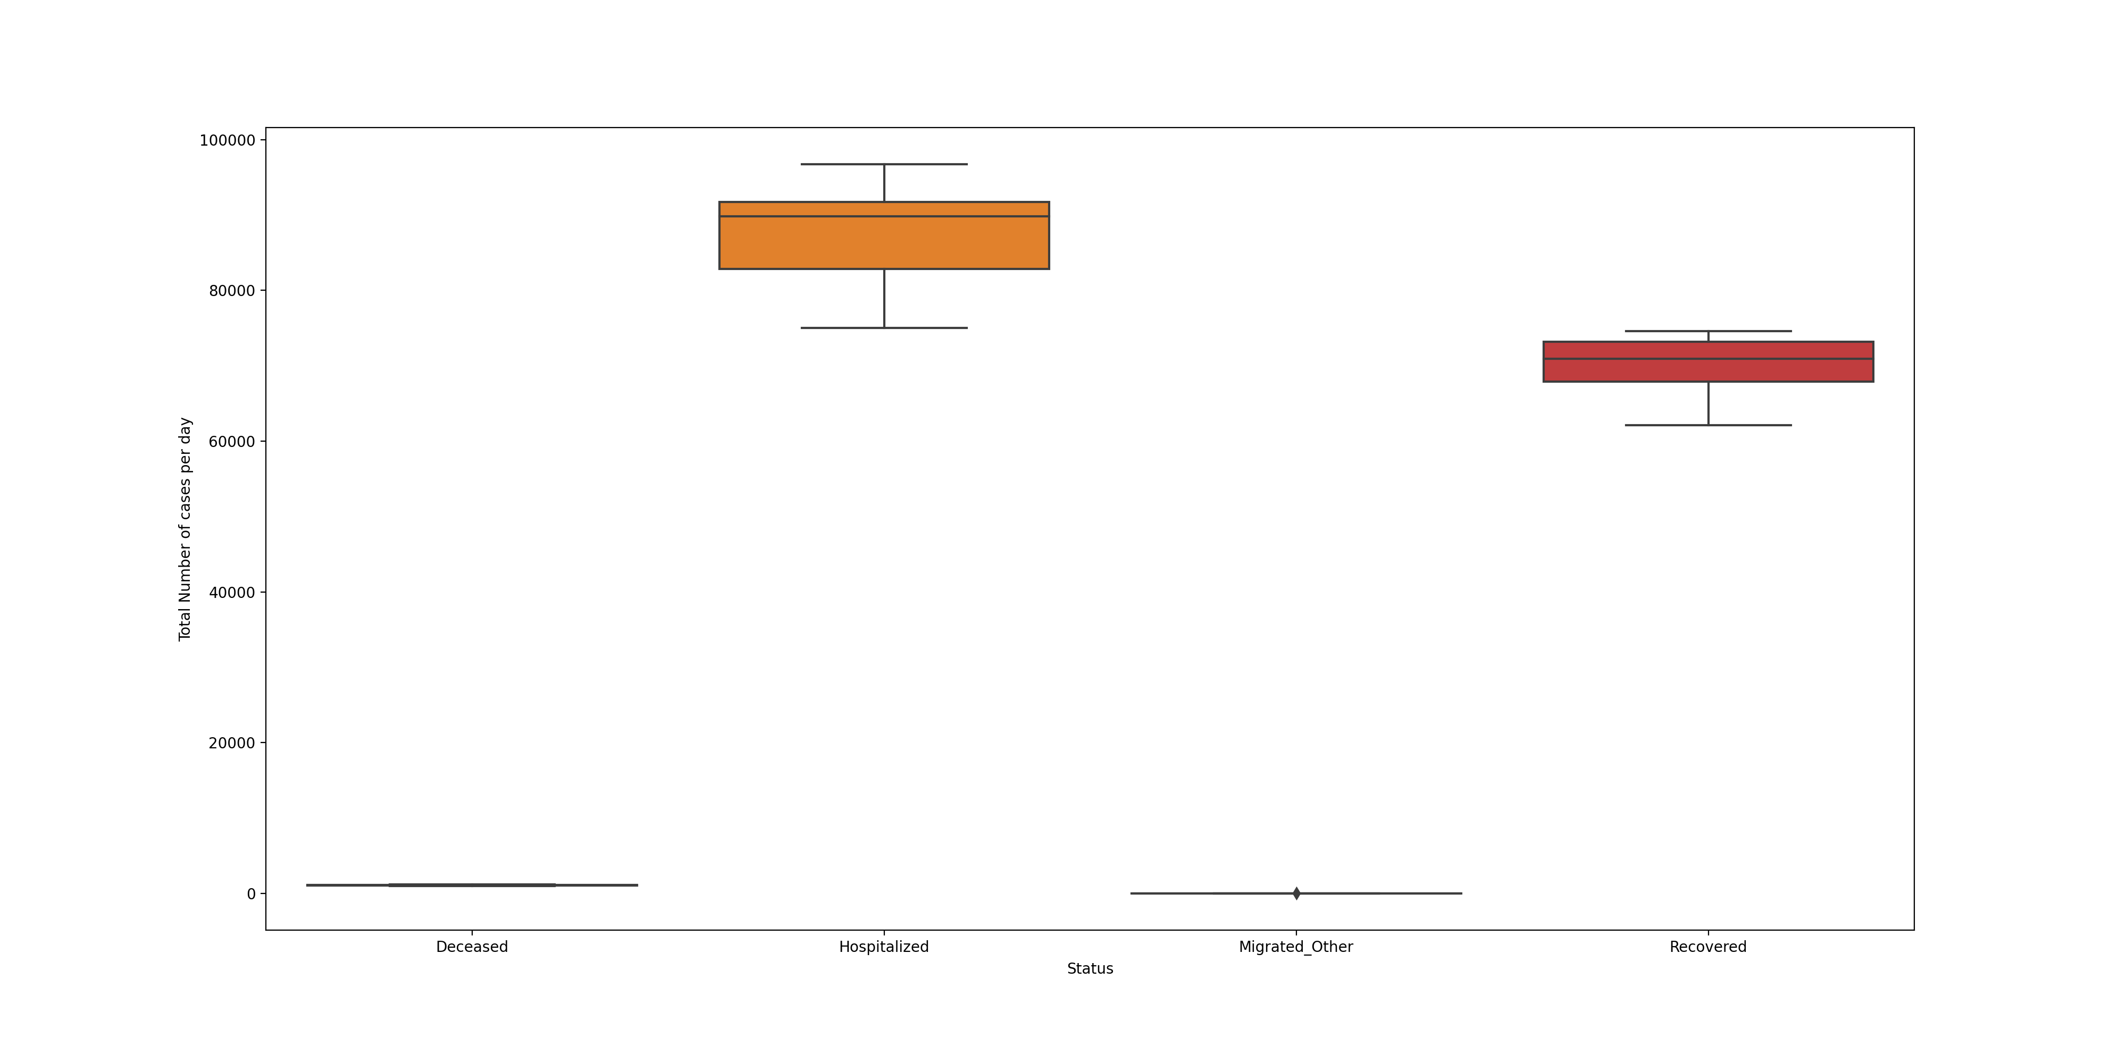
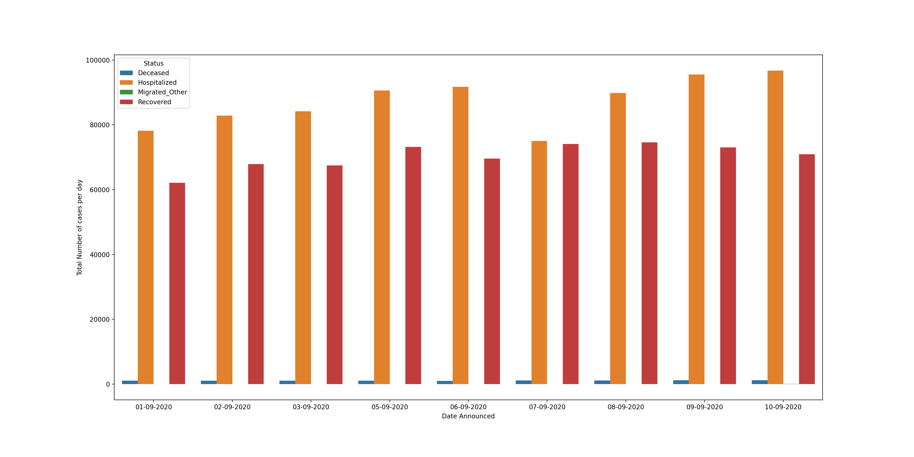
Covid Data

Slide 11
Motivation
Data is the new oil!
  New opportunities for organizations to create value!
  Competitive advantage!
Tremendous advances have taken place in statistical methods and tools, machine learning and data mining approaches, and internet-based dissemination tools for analysis and visualization.
Many tools are open source and freely available for anybody to use.
Understand the applications of statistical methods in data analytics.
Notes:
“Data is the New Oil!”
Just like oil powered industries in the past, data today powers the digital economy. Organizations that know how to collect, refine, and use data can generate immense value.
👉 Example: Companies like Google, Amazon, and Netflix are so successful because they use customer data to refine their services—just as oil was refined into fuel to drive industries.
New Opportunities for Organizations to Create Value
With the massive data generated daily, businesses and governments can create new products, improve services, and design better customer experiences.
👉 Example: Food delivery apps (Swiggy, Zomato) analyze order patterns to suggest new restaurants and offer personalized discounts, creating value for both customers and restaurants.
Competitive Advantage
Organizations that use data analytics effectively gain an edge over their competitors by making smarter and quicker decisions.
👉 Example: In e-commerce, Flipkart uses customer browsing and purchase data to recommend products, while competitors without such insights may lose sales opportunities.
Advances in Statistical Methods, Machine Learning, and Visualization
Tremendous progress has been made in statistical techniques, machine learning models, and easy-to-use visualization tools. These advances make it possible to uncover complex patterns and present them in simple ways.
👉 Example: COVID-19 dashboards used across the world relied on advanced statistical forecasting models and interactive visualizations to track cases, vaccinations, and predict future waves.
Open-Source Tools Freely Available
Many powerful tools for data analysis (e.g., R, Python, Weka, Orange, Tableau Public) are open-source and free to use, making analytics accessible to students, researchers, and startups.
👉 Example: A small business can use free tools like Google Analytics or Python libraries (Pandas, Matplotlib) to analyze customer traffic without spending huge money on paid software.
Applications of Statistical Methods in Data Analytics
Statistical methods form the backbone of analytics. Techniques like mean, median, variance, regression, and hypothesis testing help in making informed decisions.
👉 Examples:
In sports, batting averages and strike rates help in selecting players.
In business, regression analysis helps forecast sales for the next quarter.
In healthcare, statistical tests help in checking if a new medicine is effective.

Slide 12
Newer kinds of data
New kinds of data from different sources: Tweets , geo-location, Emails etc
Two major types: structured and unstructured data
For structured we have well defined schema
For unstructured we do not have well defined schema
Regardless of their differences, they work in tandem in any effective big data operation. Companies wishing to make the most of their data should use tools that utilize the benefits of both.”⁵
We will discuss methods for analyzing both structured and unstructured data
Notes:
Nowadays, data comes from a wide variety of sources, such as social media posts (tweets), GPS location data, emails, blogs, videos, and audio recordings. This shows the diversity of information that can be analysed.
Data can be divided into two main categories: structured and unstructured
Structured data is organized in a clear and specific way, often in tables with rows and columns. An example is real-time stock market data, where each piece of information fits into a specific format (e.g., date, time, price).
Unstructured data doesn’t follow a strict format and can be more complex. Examples include social media messages, news articles, speeches, books, letters, and court documents. This type of data is more difficult to analyze because it doesn’t have a consistent structure.
Even though structured and unstructured data are different, they can be used together effectively in big data operations. Companies that want to get the most value from their data should use tools that can handle both types, making sure to take advantage of their unique benefits.
There are different techniques and tools for analyzing structured and unstructured data, and these will be discussed to help understand how to work with both types of data.

Slide 13
Introduction to Data analytics
Data : Data is a set of values of qualitative or quantitative variables. It is information in raw or unorganized form. It may be a fact figure, characters, symbols etc.
Information: meaningful or organized data is information.
Analytics: Analytics is discovery, interpretation and communication of meaningful patterns or summary of data.
Data Analytics : It is the process of examining data sets in order to draw conclusion about the information it contains.
Analytics is not a tool or technology, rather it is the way of thinking & acting on data.

Slide 14
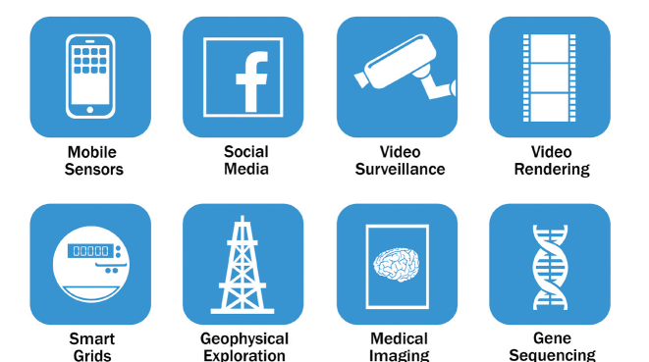
Data Overview
Data is created constantly, and at an ever-increasing rate.
  Mobile phones, social media, imaging technologies to determine a medical diagnosis
Devices and sensors automatically generate diagnostic information that needs to be stored and processed in real time.
Analysis of large amount of data is
challenging.

Slide 15
Applications of Data analytics
Personalized market to the consumer
Social Companies with Data as Primary Product
Location based advertising
Manufacturing Industry
Genetic sequencing and human genome mapping provide a detailed understanding of genetic makeup and lineage,
  Predict illness & take steps to avoid.
  Tests response to different medications.
Notes:
Example: A streaming service like Netflix uses Big Data to analyze users' viewing habits, such as what shows they watch, when they pause or stop watching, and what they search for. Based on this data, Netflix recommends personalized content that aligns with the user's preferences, leading to increased user engagement and satisfaction.
Example: Social media platforms like Facebook and Instagram collect vast amounts of user data, including likes, shares, and comments. This data is their primary product, used to create detailed profiles of users. These profiles are then used to sell targeted advertising to businesses, making the social companies highly profitable.
Example: A coffee shop chain uses location-based data to send promotional offers to customers when they are near one of their outlets. If a customer passes by a shop, they might receive a notification offering a discount on their favorite drink, enticing them to visit.
Example: In a car manufacturing plant, sensors on the assembly line collect data on machine performance. This data is analyzed in real-time to predict when a machine might fail, allowing for preventative maintenance. This reduces downtime and keeps production running smoothly.
Example: Genetic sequencing companies analyze vast amounts of DNA data to provide personalized health insights. For example, a company might sequence a person’s DNA and use that data to recommend personalized diet plans or predict susceptibility to certain diseases.

Slide 16
Attributes of Big data
1. Huge volume of data:
  Rather than thousands or millions of rows, Big Data can be billions of rows and millions of columns.
  2. Complexity of data types and structures:
  Big Data reflects the variety of new data sources, formats, and structures, including digital traces being left on the web and other digital repositories for subsequent analysis.
3. Speed of new data creation and growth:
  Big Data can describe high velocity data, with rapid data ingestion and near real time analysis.
Require new tools & technologies
Due to the vast volume, variety, and velocity of Big Data, traditional data processing tools are often inadequate. New tools and technologies have been developed specifically to store, manage, and analyze Big Data
Notes:
Example: Consider social media platforms like Facebook, which generate immense amounts of user data daily. Every post, like, comment, and interaction contributes to a vast pool of information that can be analyzed to understand user behavior, preferences, and trends.
Example: A retail company might collect data from various sources such as transactional data from its online store, customer reviews, social media mentions, and IoT sensor data from its supply chain. Each of these sources presents data in different formats and structures, requiring specialized techniques to process and analyze them.
Example: In the financial industry, stock market data streams in real-time, and traders rely on rapid analysis to make decisions within seconds. Similarly, IoT devices in smart cities generate continuous streams of data that need to be processed and analyzed in real-time to monitor and manage urban infrastructure.
Example: Apache Hadoop provides a distributed storage and processing framework that can handle large-scale data across multiple servers. Apache Spark offers fast in-memory processing, making it suitable for real-time analytics. Cloud-based platforms like Amazon Web Services (AWS), Google Cloud Platform (GCP), and Microsoft Azure provide scalable infrastructure to manage Big Data workloads.

Slide 17
Data structures
Data can be structured, semi structured & un structured.
  Eg financial data, text files, multimedia files & genetic mapping.
Structured data:
  Data containing a defined data type, format, and structure (that is, transaction data, online analytical processing [OLAP] data cubes, traditional RDBMS, CSV files, and even simple spreadsheets)
Semi-structured data:
  Textual data files with a discernible pattern that enables parsing (such as Extensible Markup Language [XML] data files that are self-describing and defined by an XML schema).
Unstructured data:
  Data that has no inherent structure, which may include text documents, PDFs, images, and video.

Slide 18
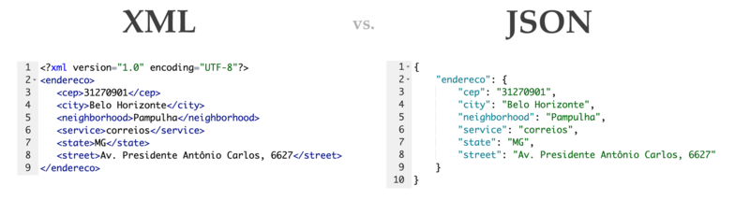
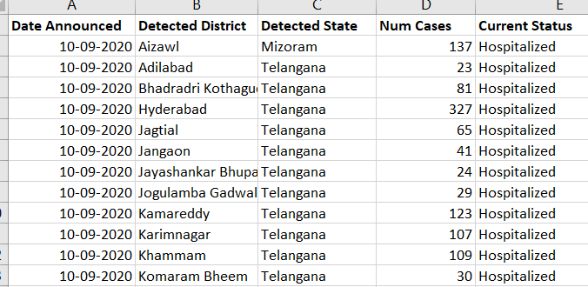


Structured semi structured and unstructured data

Slide 19
Compare and contrast structured and unstructured data
Aspect | Structured Data | Unstructured Data
1. Definition | Structured data is organized in a tabular form (rows and columns) with a predefined schema. | Unstructured data has no fixed format or schema; it is often raw and irregular.
2. Examples | Examples include employee records, student database, bank transactions. | Examples include images, videos, emails, PDF files, social media posts, sensor data.
3. Storage | Stored in Relational Databases (RDBMS) like MySQL, Oracle, SQL Server. | Stored in Data Lakes, NoSQL databases, or distributed file systems (e.g., Hadoop HDFS).
4. Processing | Easy to query and analyze using SQL queries; fast for structured analysis. | Requires advanced tools like Hadoop, Spark, NLP, and Machine Learning to extract insights.
5. Flexibility | Less flexible, as data must follow a strict schema; changes are difficult. | Highly flexible, can accommodate multiple data types and evolving formats without strict schema.

Slide 20
Highlight characteristics of big data used in data analytics
The key characteristics of Big Data used in analytics are often summarized by the 5 Vs:
Volume
Velocity
Variety
Veracity
Value
Notes:
Volume: Refers to the vast amounts of data generated every second from various sources like social media, sensors, transactions, etc. The sheer size of this data requires advanced storage, processing, and analysis capabilities.
Velocity: This characteristic highlights the speed at which data is generated, collected, and processed. Real-time or near-real-time data processing is often required for timely insights and decision-making.
Variety: Big Data comes in multiple formats such as structured data (databases), semi-structured data (XML, JSON), and unstructured data (text, images, videos). This diversity necessitates different techniques and tools to process and analyze the data.
Veracity: Refers to the uncertainty or quality of the data. Big Data can be noisy, incomplete, or inconsistent, making it essential to have robust data cleansing and validation processes to ensure accurate analysis.
Value: Ultimately, the most critical aspect of Big Data is its potential to generate value. This involves extracting actionable insights that can drive business decisions, innovation, and competitive advantage.

Slide 21
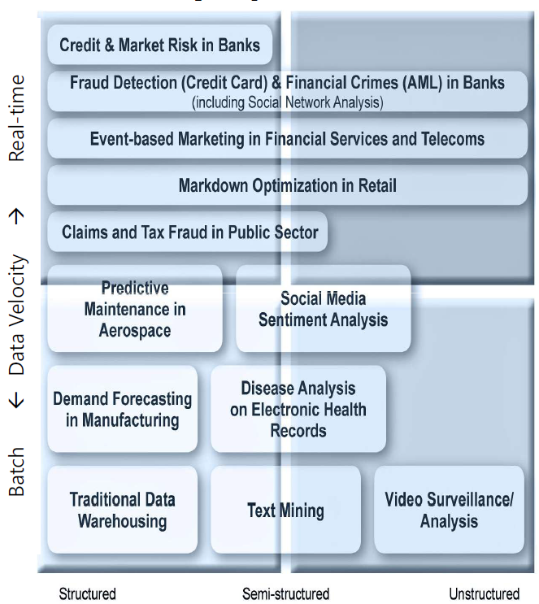
Data Structure
This image is a diagram that categorizes different types of data-related activities based on two factors: Data Structure (Structured, Semi-Structured, and Unstructured) and Data Velocity (Real-time processing and Batch processing).
Structured + Real-time:
  Credit & Market Risk in Banks: Managing risks in banking using well-organized data in real-time.
  Fraud Detection (Credit Card) & Financial Crimes (AML) in Banks: Monitoring transactions in real-time to detect fraud.
  Event-based Marketing in Financial Services and Telecoms: Using customer data in real-time to offer personalized marketing.
Notes:
Data Structure:
Structured Data: Highly organized data that fits into tables or databases.
Semi-Structured Data: Somewhat organized data like XML files or JSON files.
Unstructured Data: Data without a predefined structure, such as videos, images, or text files.
Data Velocity:
Real-time: Data is processed immediately as it comes in.
Batch: Data is collected over time and processed later.
Summary
The top half of the diagram focuses on real-time data processing, where data is processed as it arrives.
The bottom half focuses on batch processing, where data is collected and processed later.
The left side deals with structured data that is well-organized, while the right-side deals with unstructured data that is less organized, with semi-structured data in between.

Slide 22
Structured + Batch:
  Predictive Maintenance in Aerospace: Using collected data to predict when maintenance is needed.
  Demand Forecasting in Manufacturing: Analyzing past data to forecast future demand.
  Traditional Data Warehousing: Storing and managing large amounts of structured data for later analysis.
Semi-Structured + Real-time:
  Social Media Sentiment Analysis: Analyzing social media posts in real-time to understand public sentiment.
Semi-Structured + Batch:
  Disease Analysis on Electronic Health Records: Using health records to analyze diseases over time.
  Text Mining: Extracting information from text data, often done in batches.
Unstructured + Batch:
  Video Surveillance/Analysis: Analyzing video footage, usually done after the fact in batches.

Slide 23
Data Repositories
Spreadsheets and Their Use:
Spreadsheets Enabled Business Users:
Does Not Require database Training:
Can Be Set Up Quickly:
Easy to Share:
End Users have Control Over the Logic:
Challenges with Spreadsheets:
"Many Versions of the Truth":
Challenging to Determine the Most Relevant Version:
Data and Logic Could Be Lost:
Proliferation of Data Islands:
Unscalable:
Notes:
Spreadsheets are a tool that allows people to organize data into rows and columns, much like a table. Business users can use them to create formulas and calculations to analyze business problems without needing advanced technical skills.
You don't need special training or knowledge of databases to use a spreadsheet. It's simple enough for most people to learn and use on their own.
You can start using a spreadsheet almost immediately. Just open a new file, enter your data, and you’re ready to go. There’s no complex setup process.
Spreadsheets can be easily shared with others, either by emailing the file or using cloud services like Google Sheets or Excel Online. This makes collaboration straightforward.
The person using the spreadsheet has full control over the formulas and calculations. They can decide how the data is processed and analyzed according to their needs.
Challenges with spreadsheet
When multiple people work on or share the same spreadsheet, they might create different versions. It can be difficult to know which version has the most accurate or up-to-date information. This can lead to confusion.
Since there might be many versions of the same spreadsheet floating around, it’s hard to tell which one has the latest data or the correct formulas. This could lead to wrong decisions if an outdated or incorrect version is used.
If the computer (laptop) where the spreadsheet is stored gets lost, stolen, or damaged, or if the file gets corrupted, all the data and calculations in the spreadsheet could be lost. This could be a significant setback, especially if there’s no backup.
When different spreadsheets are used by different people or departments, the data becomes scattered or isolated in separate files. This is called "data islands," and it makes it hard to get a complete and accurate picture of the information because it’s spread out in various locations.
Spreadsheets work well for small amounts of data or simple analyses. However, as the amount of data grows or the analysis becomes more complex, spreadsheets can become slow, difficult to manage, and prone to errors. They aren’t designed to handle large-scale data analysis efficiently.
Summary
Spreadsheets are great for quick, easy, and user-controlled data analysis, but they come with risks, especially when it comes to managing multiple versions, ensuring data security, and handling large amounts of data. As businesses grow, relying solely on spreadsheets can lead to inefficiencies and data management challenges.

Slide 24
Enterprise Data Warehouse
An Enterprise Data Warehouse is a large system that stores all of a company's data in one central place. It's designed to help businesses manage, analyze, and report on their data efficiently.
Why use an EDW’s?
Companies often have data scattered across different departments and systems. An EDW brings all this data together in one place, making it easier to access, analyze, and make decisions based on the full picture.

Slide 25
Advantages of EDW
Scalable
Data Managed Centrally:
Benefits of Security, Failover, & Single Repository:
Data Accuracy:
Notes:
EDWs are designed to handle large amounts of data. As a business grows and collects more data, the EDW can expand to accommodate this growth without becoming overwhelmed.
All data is stored and managed in one place. This central management makes it easier to keep track of data, ensure it's up-to-date, and maintain consistency across the organization.
Benefit of security, failover and single repository
Security: Since the data is all in one place, it’s easier to protect it with strong security measures.
Failover: If something goes wrong, like a system failure, there are backup systems in place to keep the data safe and the EDW running.
Single Repository (Official Source): The EDW serves as the "single source of truth" for the organization. Everyone uses the same data, so there’s no confusion about which numbers are correct.
Because the data is managed centrally, there are strict rules and processes to ensure that the data is accurate and reliable. This means fewer errors and more trustworthy data for analysis.

Slide 26
Disadvantages of EDW
Restrict the Flexibility Needed for Robust or Exploratory Data Analysis:
Longer Lead Times:
EDW Rules Restrict Analysts from Building Datasets:
Dislike of Outside Data Existence by IT Groups:
Notes:
Since the EDW is tightly controlled by the IT department, it can be challenging for analysts to experiment with the data or explore it in new ways. The strict controls can limit creativity and flexibility in analysis.
Making changes or adding new data to the EDW can take time because everything has to go through the IT department. This can slow down the process and make it harder to respond quickly to new business needs.
The rules and processes around the EDW are often very strict, which means analysts may not have the freedom to create their own datasets or work with the data in the way they want. This can be frustrating for those who need to do more in-depth or specialized analysis.
IT departments managing the EDW may not like it when data is stored outside the EDW, such as in separate spreadsheets or other databases. They prefer everything to be in one place, which can cause tension if analysts want to use outside data sources.

Slide 27
Analytic Sandbox (Workspaces):
What is an Analytic Sandbox?
An analytic sandbox is a separate space where analysts can work with data more freely without the strict controls of the EDW.
It’s like a playground where they can experiment, explore, and create new analyses without affecting the main data warehouse.
Why use Analytical sandbox
It gives analysts the flexibility they need to explore data, test new ideas, and perform more complex analyses without waiting for IT to approve change
It’s a compromise that allows for creativity and exploration while keeping the main EDW safe and secure.
Notes:
Summary:
EDWs are great for centralizing and securing data, ensuring accuracy, and scaling as a business grows. However, they can be restrictive and slow for analysts who need more flexibility.
Analytic sandboxes provide a solution by giving analysts a space to work independently while maintaining the security and integrity of the main EDW.

